Slide 1
Definition of Forgetting:
1. Cessation of memory to be had.
2. M. Cessation of affection to be had.
3. M. Neglect of something that should be kept in mind

Slide 2
Now I am going to ask you a question:
¿ did u forget me?

Slide 3
If you did, I m going to remember u who I was

Slide 4
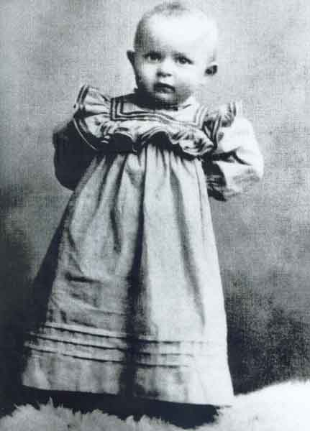
¡ Hello, I am Lolek! And this is my story
I was born on 18 May Wadowaice, Poland

Slide 5
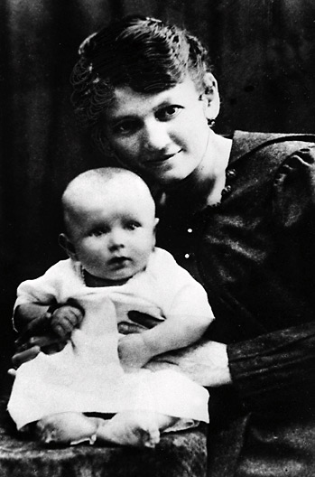
She is my mom, Emilia was called, she went with God, but gave me the best gift, Life

Slide 6
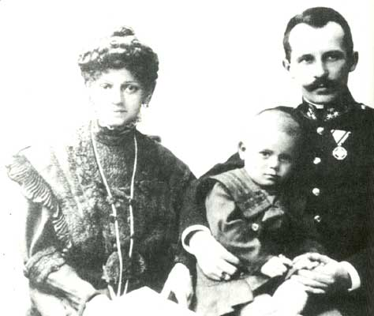
My parents left me very soon And I had to walk alone; good that I thought I would but ...

Slide 7
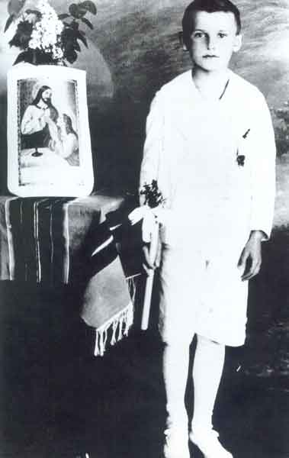
I met my best Friends at 8 years And you know… … I never neglect!

Slide 8
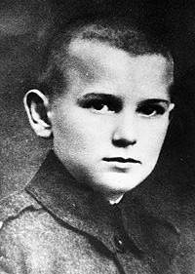
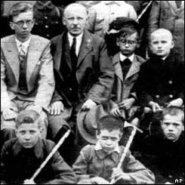
I was a joyful young, I liked soccer, swimming and was a very good student

Slide 9
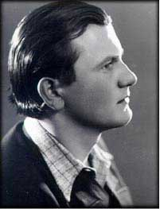
When I grew up I liked to do theatre, but my friends insisted I continue much they know and convinced me…

Slide 10
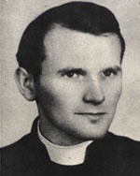
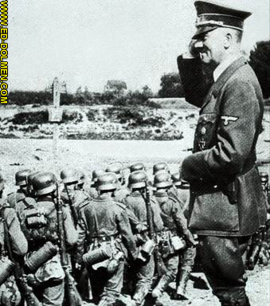
I lived the horrors of the Second World War, I could not go to school by the Nazis and had not allowed us to do it secretly

Slide 11
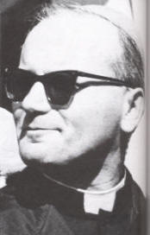
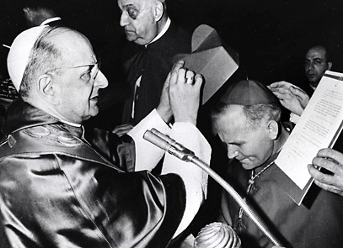
I surrendered my life to my friend, and everytime I wanted more…

Slide 12
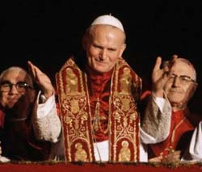
one day, I was appointed to be responsible of your company and then my life and maybe yours has changed.

Slide 13
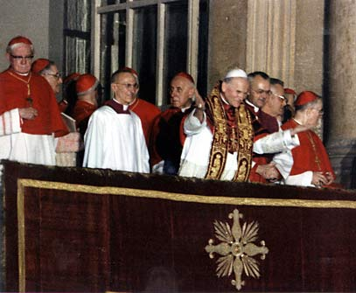
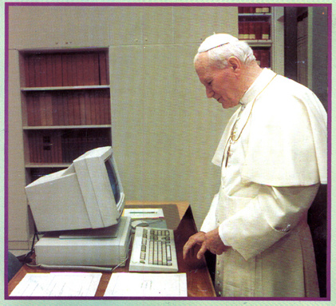
I had to work hard
And wise supported Of all
It had to use All the tools In my scope

Slide 14
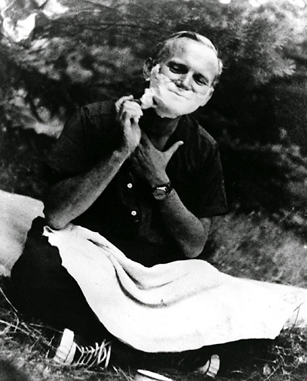
There were people who believed that I was not a normal person and wrong

Slide 15
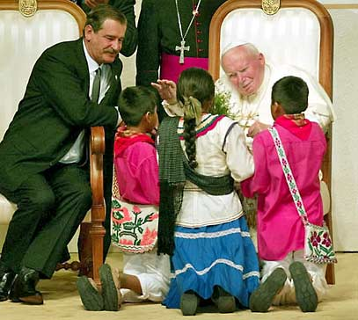
I made some friends…

Slide 16
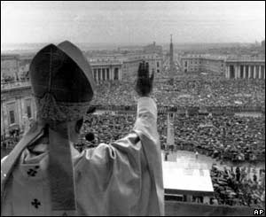
Only a few…

Slide 17
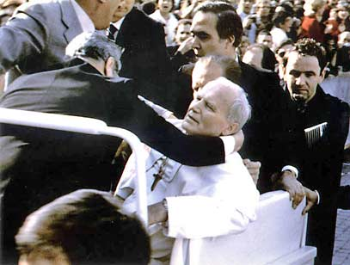
Sometime I fell ..

Slide 18
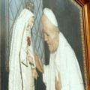
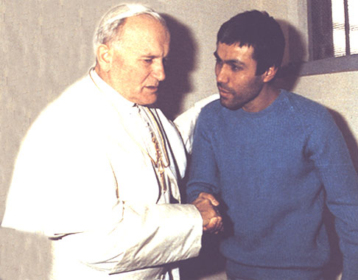
But with love, i stand up
And forgive

Slide 19
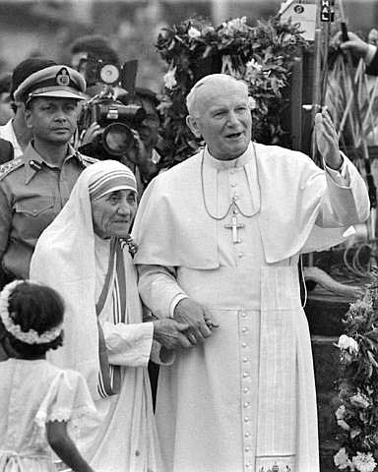
I realized that i was not lonely
there were people who shared my love For
other people

Slide 20
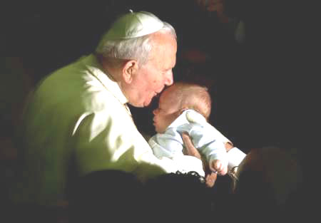
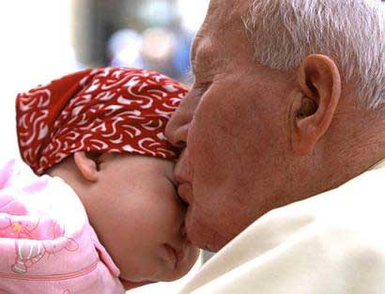
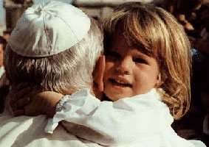
And my love for children

Slide 21
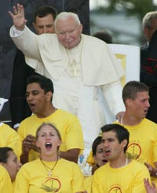
And for young people, who I was searching so many times, At the end they came to me

Slide 22
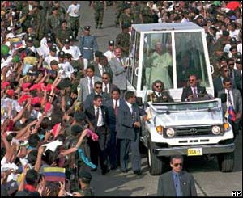
I traveled and I knew you

Slide 23
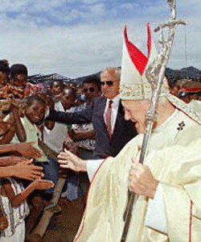
We were together many times

Slide 24
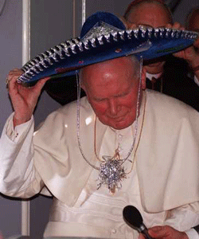
I realized that it was Mexican!

Slide 25
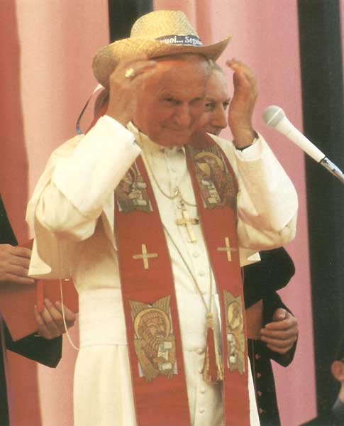
I would like to identify myself with you

Slide 26
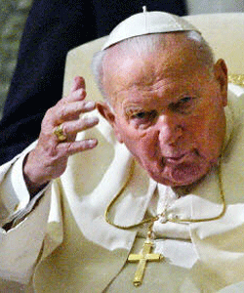
But the time is over…

Slide 27
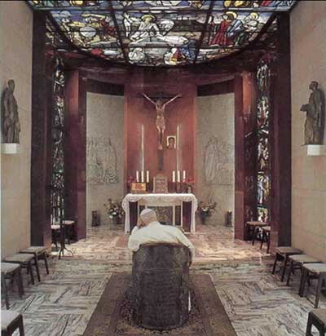
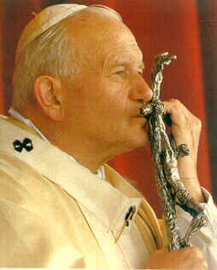
I would have liked to continue with you but it is time to see my friend
And say, THE MISSION ACCOMPLISHED!

Slide 28
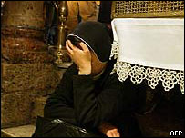
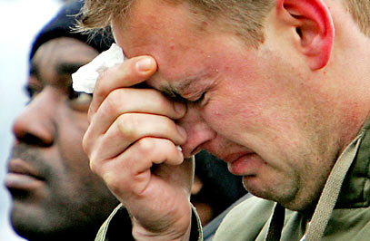
I have seen people shed tears for me

Slide 29
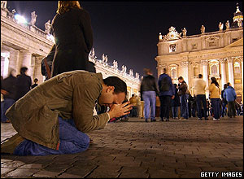
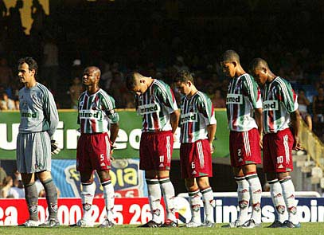
I have seen them very sad

Slide 30
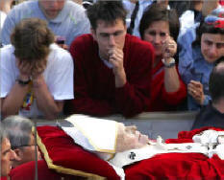
I have seen them suffering for me

Slide 31
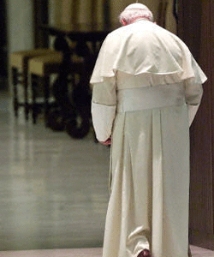
Don’t feel that u are walking alone, cause I never did!

Slide 32
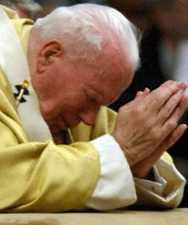
I asked for you

Slide 33
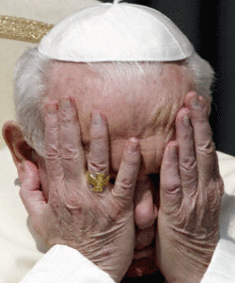
And for your sins

Slide 34
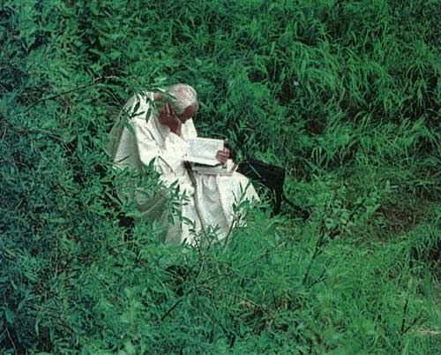
Keep praying to God

Slide 35
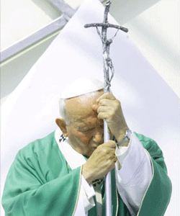
Hand it strongly

Slide 36
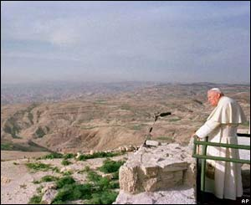
See his Greatness, compared to the smallness of the problems

Slide 37
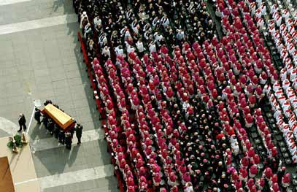
And thanks for being with me!!!

Slide 38
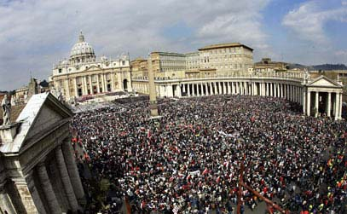
Thanks for proving how much you need me !!!!!!

Slide 39
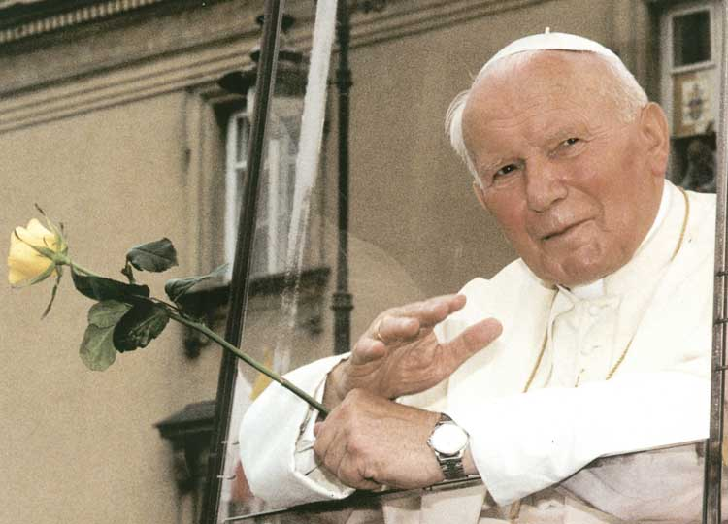
Also i need you

Slide 40
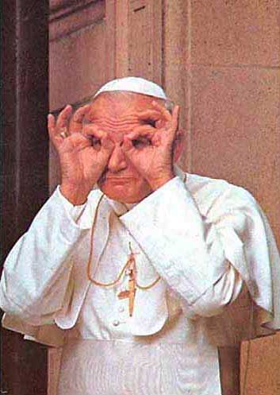
And I will be watching you

Slide 41
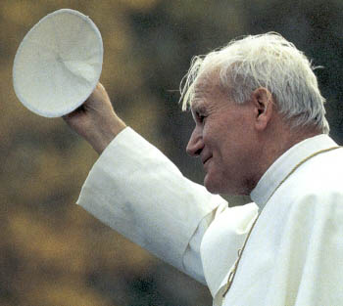
I will never forget you

Slide 42
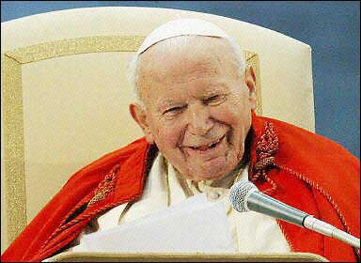
Remember me smiling !!!!!

Slide 43
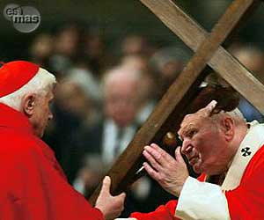
Help my brother, who will continue with the work of Christ

Slide 44
And that they will not forget something

Slide 45
¡¡¡What I would like but I am not going, I will leave but I am with you until the end of time!!!!!

Slide 46
Jean Paul II
2nd Anniversary of his meeting with God

Slide 47
Please pass this e-mail.

