Slide 1
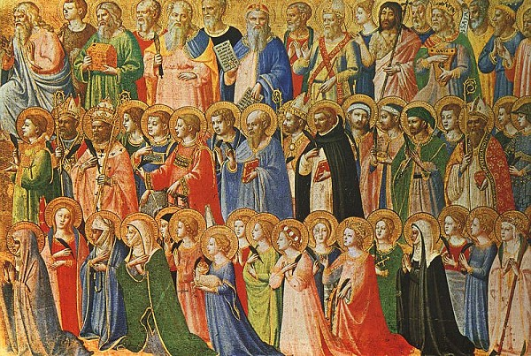
THE CALL TO BE SAINTS

Slide 2
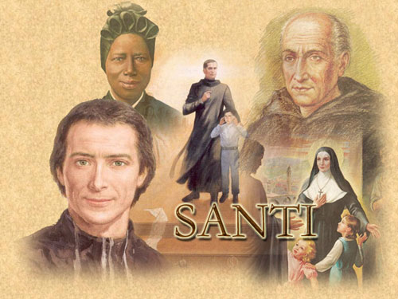
We are Called to be Saints
SAINTS – HOLY PEOPLE - SANCTI

Slide 3
Who are the Saints?
We must remember the GOD alone is HOLY. He is THE SAINT.
Those people who love God and obey his law during their life become saints because they are God’s friends. God makes them Holy. He makes them Saints.
When we were baptized we received this calling to become saints.
All the souls in heaven are saints.

Slide 4
All the souls in heaven are Saints.
In heaven all the souls are with God and so they become Holy like HIM
SAINTS (HEAVEN)
Souls who are proclaimed by the Church as saints. They are examples for us.
Souls who are not proclaimed by the Church as saints.

Slide 5
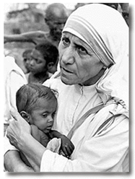
Process to become a Saint ordered by the Church
Death of the Holy Person
Servant of God
Venerable
Blessed
Saint

Slide 6
Do we adore Saints?
No, we do not adore saints. Adoration can only be given to God. We adore God alone. We give veneration and respect to the saints. They are very special people, but they are not gods. They can never replace God. They lead us to God. They lived like us in this world. They had difficulties and challenges. They were sinners. But they tried to love God above everyone and everything. They are an example for us. If we imitate them, we can also go to heaven to be with God forever.

Slide 7
Examples of Saints
St. Peter the Apostle who died as a martyr

Slide 8
Examples of Saints
St. Francis of Assisi (1182-1226)

Slide 9
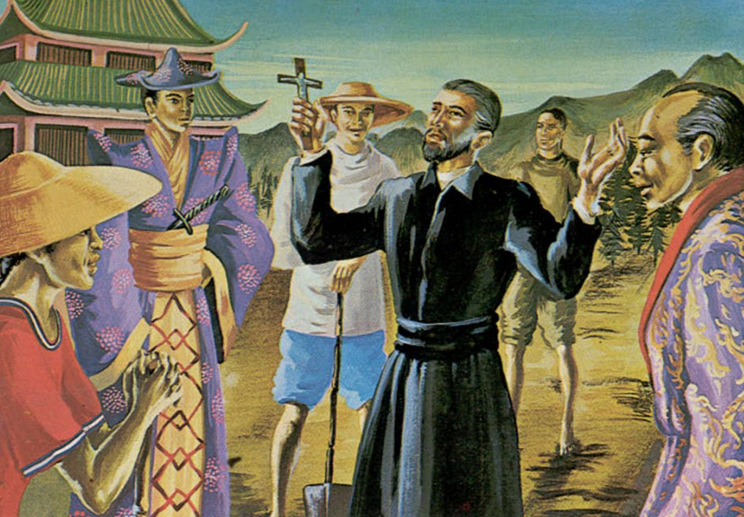
Examples of Saints
St. Francis Xavier the Missionary

Slide 10
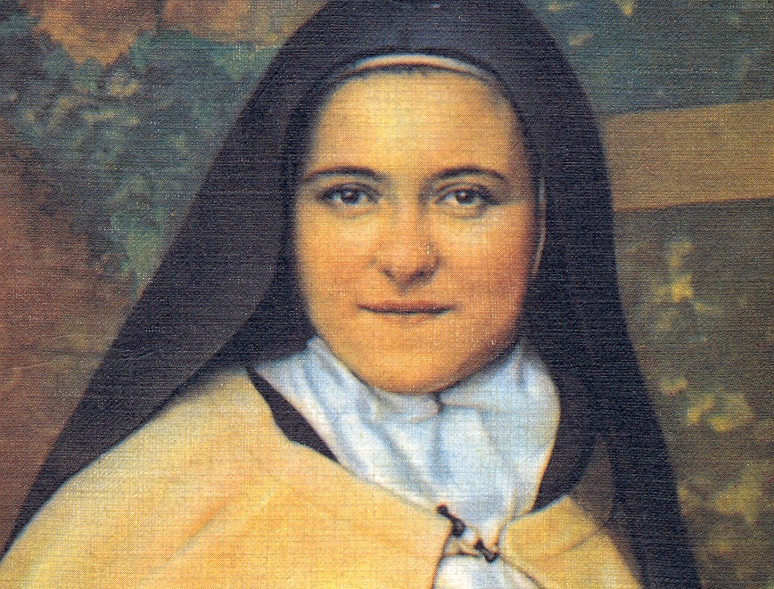
Examples of Saints
St. Therese of the Child Jesus

Slide 11
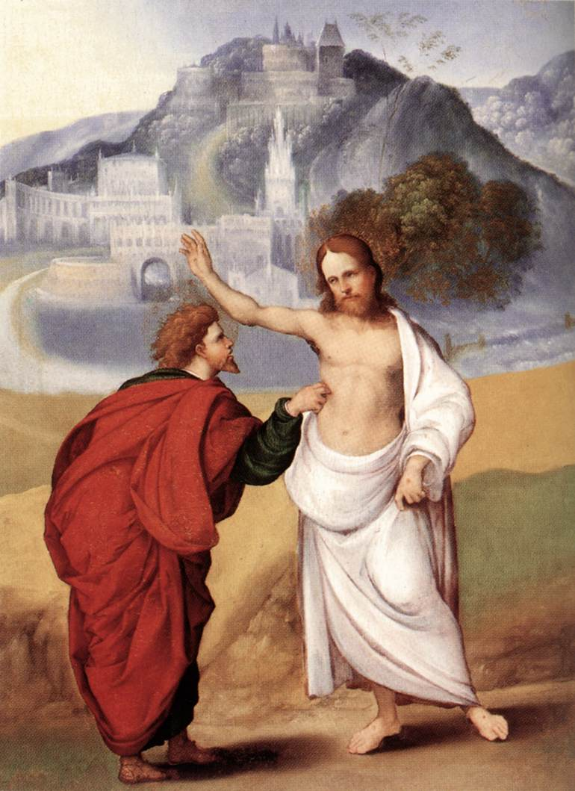
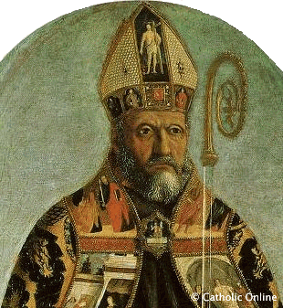
Examples of Saints who were sinners
St. Thomas
St. Augustine

Slide 12
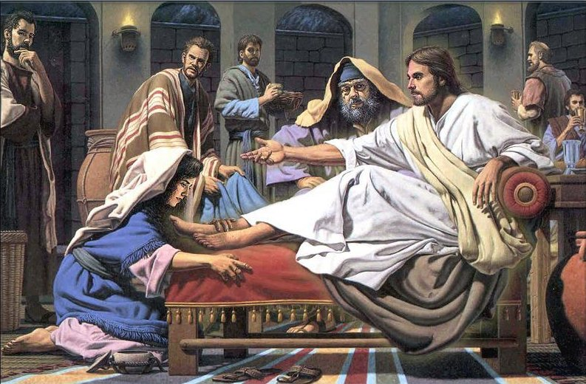
St. Mary Magdalene

Slide 13
Sayings about Saints
God creates out of nothing. Wonderful you say. Yes to be sure, but he does what is still more wonderful: He makes saints out of sinners. (Kierkegaard)
A rude person cannot become a saint (Hillel)
The simplest and most effective way to sanctity is to disappear into the background of ordinary everyday routine. (Merton)

Slide 14
Why were the Saints, Saints?
Because they were cheerful when it was difficult to be cheerful.
Because they were patient when it was difficult to be patient.
Because they kept silent when they wanted to talk.
Because they were agreeable when they wanted to be disagreeable.
Because they pushed on when they wanted to stand still.
That was all. It was quite simple and always will be!

