Slide 1
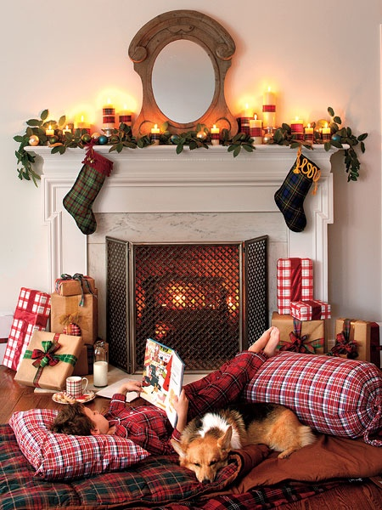
A Christmas Story
Adapted from Francois Coupee

Slide 2
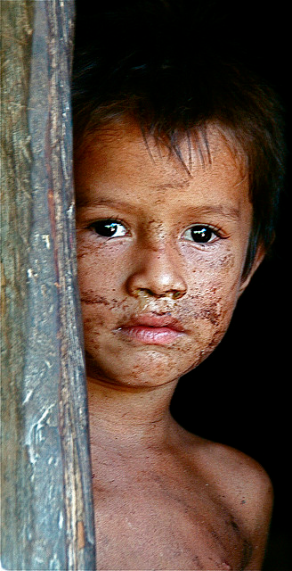
This story is about a poor boy who knew what Christmas was all about…

Slide 3
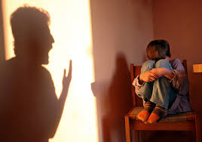
Little Hans lived
with his aunt,
who was quite
an old lady.
She was not
always kind to Hans, but this made no difference to him.
He loved her just
the same and forgot the many times
she was
cross to him.

Slide 4
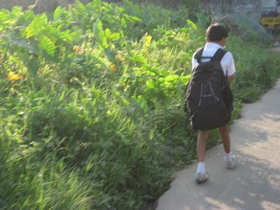
Hans went to
school with
many other
boys, but he
was the poorest
boy in school. He
had to wear
the same
clothes in
summer
as in winter.

Slide 5
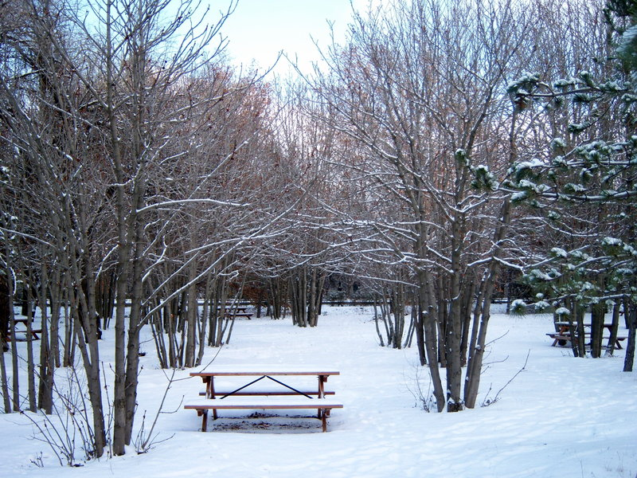
It was now
midwinter, when everything
was wrapped
in snow and
glazed with ice,
while the
north winds
sang loud
and whistled
down the
chimneys.

Slide 6
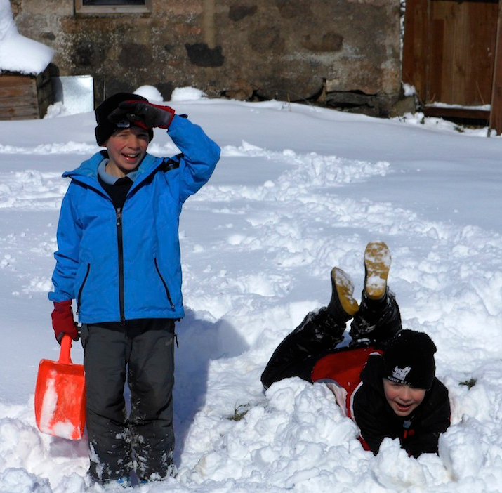
The frost, too,
was busy
pinching the
cheeks and
biting the toes
of the boys,
and making
them run,
jump and
dance to
keep warm.

Slide 7
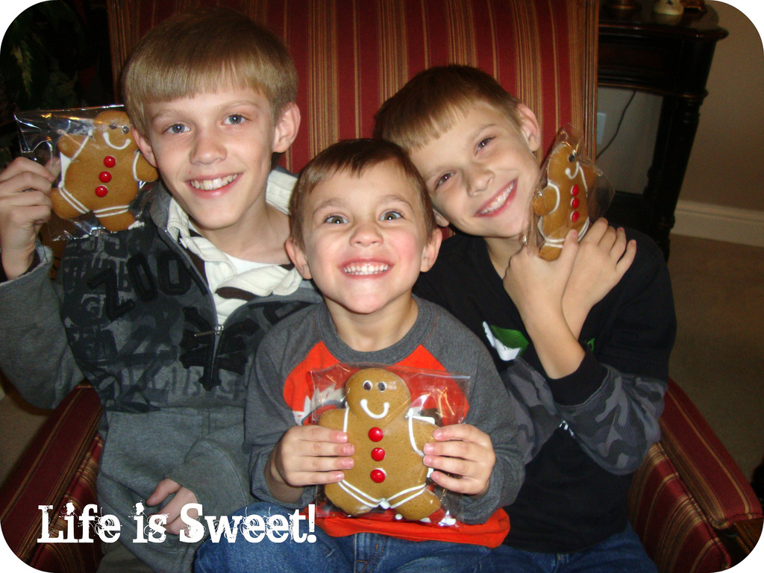
The children
were wild
with the excitement
and the joy
that was astir
at this time.
For there were
secrets in the
air. Every one
was busy
making gifts
for some
loved one.

Slide 8
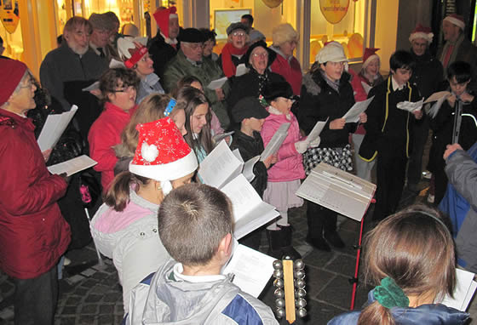
It was the
night before Christmas, the one great
birthday on
which the whole
world rejoiced.
The schoolmaster
and all of his
pupils started
for the midnight
worship and
prayer at the
church.

Slide 9
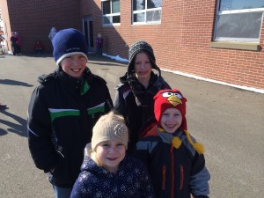
All of the boys were well clothed, with heavy coats, fur caps, thick mittens, and very heavy and warm shoes.

Slide 10
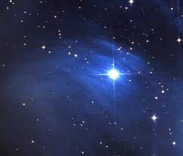
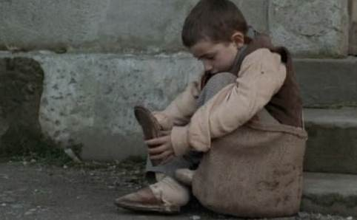
But little Hans had only a poor, plain, ragged suit, with no overcoat, no mittens, and his shoes were only wooden ones. It was a very cold night, and the boys and the schoolmaster had to walk very fast to keep warm. But little Hans did not mind the cold so much, because the stars smiled down upon him.

Slide 11
At last they reached the church. It was a beautiful place to Hans. He loved it dearly, and was always happy to come here. The candles were all lighted, and they burned steadily brighter and brighter, filling the church with a beautiful mellow light.

Slide 12
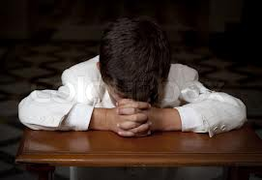
After the people had sung, each one knelt and offered thanksgiving to the Heavenly Father. Little Hans, too, knelt and offered thanks for the blessings which he had received during that year.

Slide 13
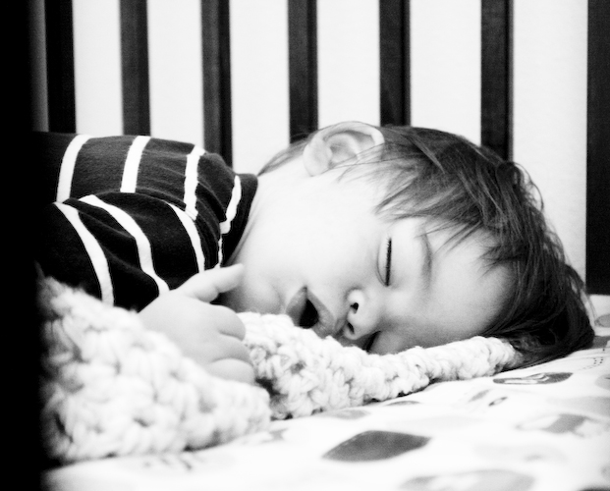
The people then quietly passed out of the warm church into the cold of the night. Hans was the last one out, and as he carefully made his way down the icy steps he noticed a little boy no larger than himself sitting on the steps, with his head resting against the church.

Slide 14
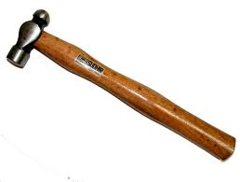
He was fast asleep. His face was beautiful, and seemed clothed in a golden light. Beside him, tied in a cloth, were a square, a hammer, a saw and other tools of a carpenter.

Slide 15
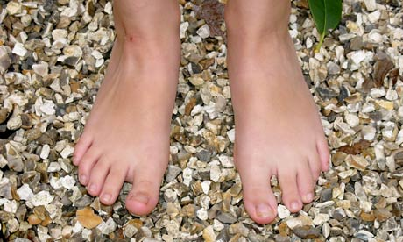
He had neither
shoes nor stockings
on his feet,
although his
clothing was
spotless and of the
purest white.
It grieved Hans
to see a poor
child liked that.
It made him sad.

Slide 16
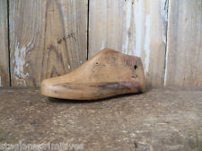
Hans stopped and took from his right foot
the wooden shoe
and placed it in
front of the
sleeping child.
Hans then limped
along on the ice and snow, not feeling how cold it was, but only thinking of the poor child asleep out in the cold.

Slide 17
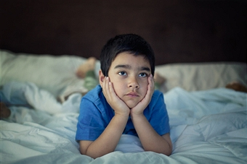
When Hans arrived home he found his aunt awaiting him, and when she saw that he had only one shoe, and he had told her all about the other one, she was very angry with him, and sent him to bed.

Slide 18
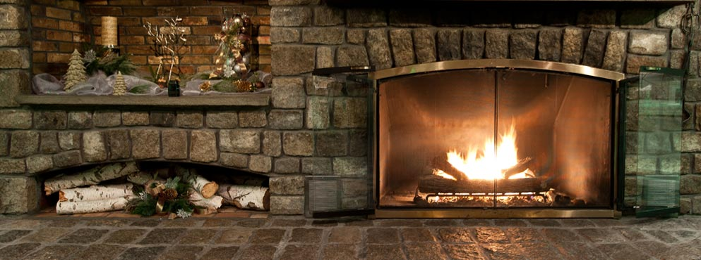
Hans placed the wooden shoe from his left foot at the fireside, hoping that Santa would remember him and bring him even one small gift.

Slide 19
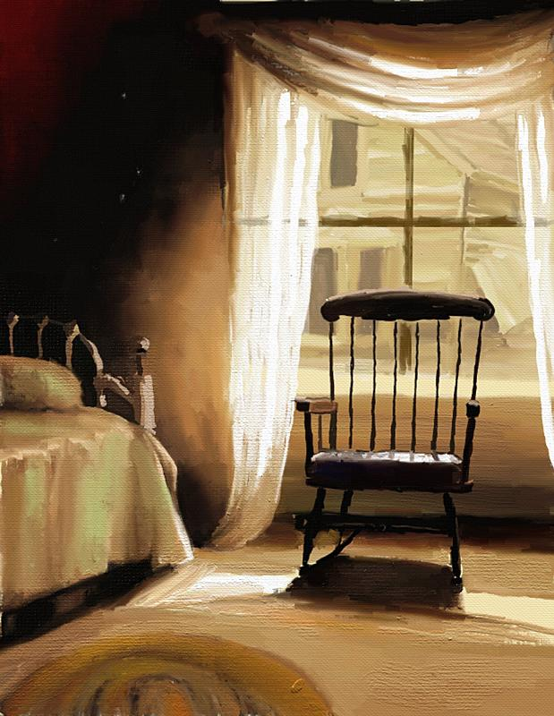
The first sunbeam that crept into Hans's bedroom and kissed him the next morning awoke him, and he bounded downstairs, and flew to the great open fireplace to find his shoe.

Slide 20
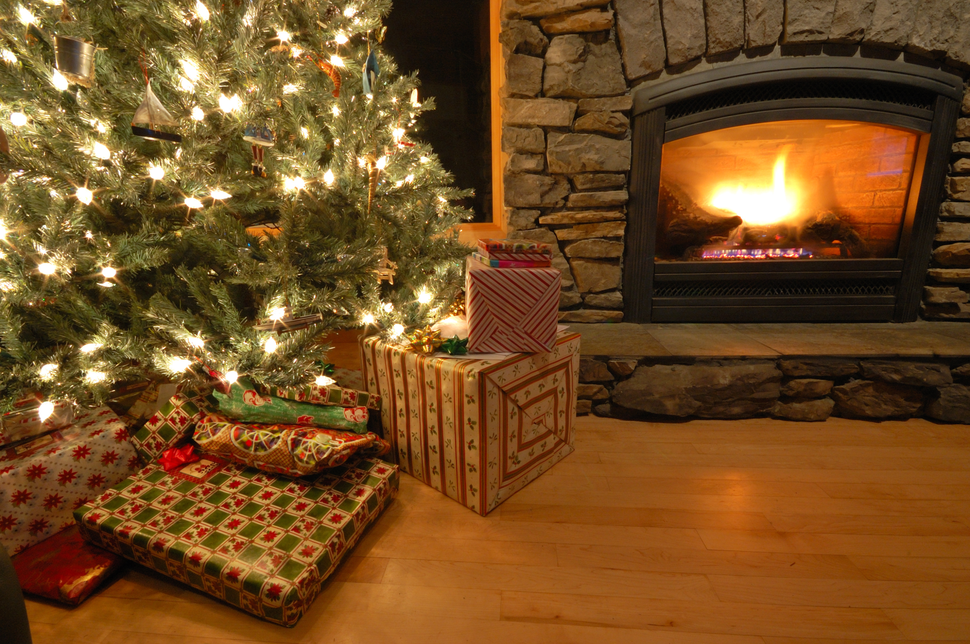
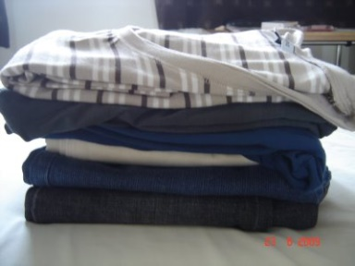
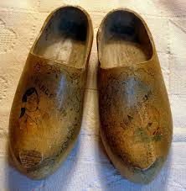
Hans rubbed his eyes and caught his breath, for, to his great surprise, there were both of his wooden shoes, filled with beautiful toys; by the fireside he found warm clothing and many other things to make him comfortable and happy.

Slide 21
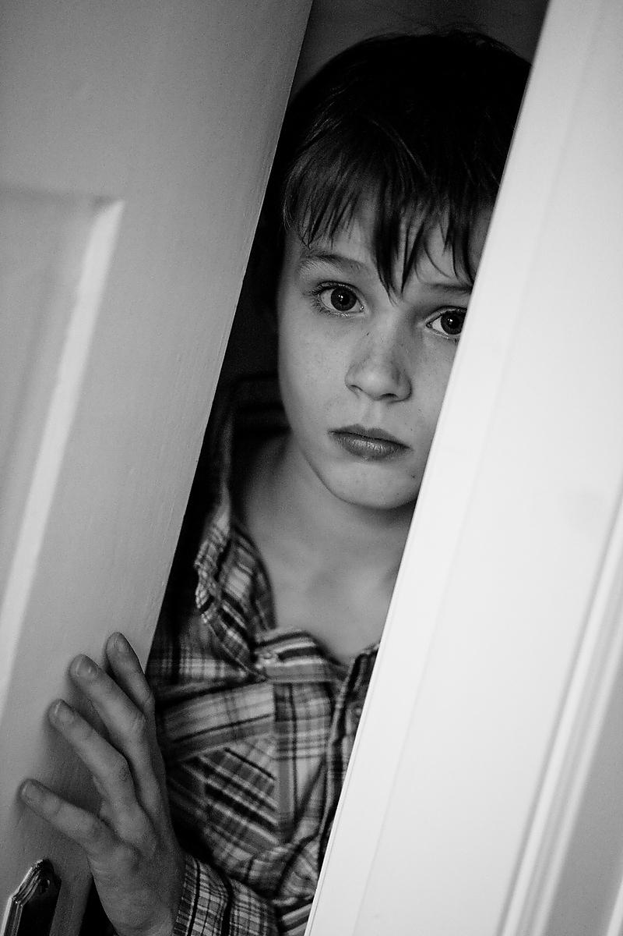
Hearing loud
voices,
Hans went to
the door.
The people were standing in
a crowd
about the
priest, who
was talking
to them.

Slide 22
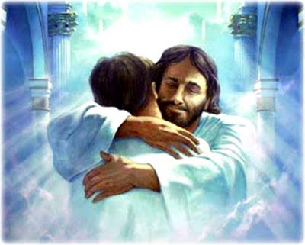
He said that the child was Jesus himself, whom the Heavenly Father had again sent among men on earth for that night, and that it was He with whom Hans had shared his wooden shoes.

Slide 23
Think and discuss…
Who was Hans ?
With whom did he live ?

Slide 24
Think and discuss…
Where do you think did the story happen ?

Slide 25
Think and discuss…
How do we know that the people were Christians ?

Slide 26
Think and discuss…
How do we know that the people were Christians ?

Slide 27
Think and discuss…
In what way was the sleeping boy similar to Jesus ?

Slide 28
Think and discuss…
Name a word that best describes Hans.

Slide 29
Think and discuss…
What happens when Hans woke up the following day ?

Slide 30
Think and discuss…
Do you think you can make a person happy? How ?

Slide 31
Think and discuss…
What do you think is the true meaning of Christmas ?

